Slide 1


Jason McIntire
December 30, 2023

Slide 2

Outline
Executive Summary
Introduction
Methodology
Results
Conclusion

Slide 3
Executive Summary
Methodologies Used:
Data collection
Rest API
Web scraping
Data Wrangling
Exploratory Data Analysis
Data Visualization
Folium (maps)
Plotly Dash (dashboard)
Predictive Analysis (Machine Learning)
Summary of all results:
Exploratory data analysis results
Interactive analytics demo in screenshots
Predictive analysis results

Slide 4
Introduction
This project was launched to review historical SpaceX launch data to determine how we can predict the success of future launches.
In particular, I want to discover the best model to be used for accurately predicting the success of a given future launch.

Slide 5

Section 1

Slide 6
Methodology
Executive Summary
Data collection methodology:
Data was collected from the SpaceX API And by scraping data from SpaceX Falcon 9 launch Wikipedia page
Perform data wrangling
We ensured there were no missing values, and created a new column that indicated the success or failure (class) of each launch, based on Outcome
Perform exploratory data analysis (EDA) using visualization and SQL
Perform interactive visual analytics using Folium and Plotly Dash
Perform predictive analysis using classification models
Using SciKit-Learn to determine best classification model to calculate the best model to predict launch success

Slide 7

Data Collection
Historical launch data was collected from the SpaceX API And by scraping data from SpaceX Falcon 9 launch Wikipedia page.
SpaceX API
https://api.spacexdata.com/v4
Launch history
Booster version
Launchpad Location
Payload Size
Core Specs
Wikipedia Tables
https://en.wikipedia.org/wiki/List_of_Falcon_9_and_Falcon_Heavy_launches
HTML table with all data needed for data analysis

Slide 8
Data Collection – SpaceX API
GET https://api.spacexdata.com/v4/launches/past
GET https://api.spacexdata.com/v4/rockets
After retrieving a collection of all past launches, subsequent data was retrieved to get:
Booster version
Launchpad location
Payload size
Cores
GET https://api.spacexdata.com/v4/launchpads
GET https://api.spacexdata.com/v4/payloads
GET https://api.spacexdata.com/v4/cores
View Jupyter Notebook on GitHub

Slide 9
Data Collection - Scraping
Convert data output from Wikipedia to BeautifulSoup object
Data was collected via web scraping from:
https://en.wikipedia.org/wiki/List_of_Falcon_9_and_Falcon_Heavy_launches
Locate the required table from within the BeautifulSoup object
Extract column names
Parse HTML table into a dictionary object
Generate a pandas DataFrame from the dictionary object
View Jupyter Notebook on GitHub

Slide 10
Data Wrangling
Evaluate data for null values
Determine the number of launch sites
This flowchart demonstrates the process we undertook when wrangling the data for this project
Determine the unique outcomes
Classify each outcome to a success (1) or failure (0)
Add a column to the DataFrame with the “class” indicating success or failure
View Jupyter Notebook on GitHub

Slide 11
EDA with Data Visualization
During the EDA process, we plotted the following:
Chart Type | Feature 1 | Feature 2 | The Purpose of This Chart is to show…
Scatter | Flight Number | Payload Mass | The payload mass changed over time, as the flight numbers are sequential
Scatter | Flight Number | Launch Site | The use of launch sites has changed over time, as the flight numbers are sequential
Scatter | Payload Mass | Launch Site | If some launch sites were chosen based on their payload mass
Bar | Orbit | Success Rate | The success rate of launches based on their orbit
Scatter | Orbit | Flight Number | The flight orbit has changed over time, as the flight numbers are sequential
Scatter | Payload Mass | Orbit | The occurrence of launch payload mass in each orbit
Line | Date | Class | The success rate by month, in chronological order
View Jupyter Notebook on GitHub

Slide 12
EDA with SQL
The following queries were used in EDA:
Select distinct landing outcomes
Select 5 launches in sites whose name starts with “CCA”
Select total payload mass where NASA was the customer
Select average payload mass for v1.0 Falcon 9 launches
Select date of the earliest successful ground pad launch
Select boosters that have successfully landed on a drone ship with a payload mass between 4000 and 6000 kg
Select the count of missions with each mission outcome
Select boosters that have carried the maximum payload
Select month, landing outcome, booster version, and launch site for launches in 2015
Select outcomes and their count in descending order between June 4, 2010 and March 20, 2013
View Jupyter Notebook on GitHub
12

Slide 13
Build an Interactive Map with Folium
Folium Map Objects:
Launch Sites
CircleMarker – marks each launch site with a pin-style marker with a circle around the point.
Marker – Provides a popup description of the marker when clicked on
MarkerCluster – a group of markers at the launch site that show the successful (green) and failed (red) launches at that site when clicked
Landmarks
DivIcon – a label that shows the distance that was measured from the nearest launch site to this position
PolyLine – a line connecting the launch site to the landmark
View Jupyter Notebook on GitHub

Slide 14
Build a Dashboard with Plotly Dash
Dashboard Characteristics (Features and Interactions):
Dropdown - options to view all sites, or select a specific site
Pie chart – automatically updates when the Launch Site dropdown is changed.
When all sites are selected, it will compare the successful launches for the different sites
When a specific site is selected, it will compare success vs failure for that site
Slider – allows restricting the payloads that will be shown on the scatter plot
Scatter Plot – automatically updates when the Launch Site dropdown OR the Payload Slider are changed. It displays the launches for the given site(s) and the payloads within the range selected
View Jupyter Notebook on GitHub

Slide 15
Predictive Analysis (Classification)
Model Selection was done by comparing accuracy among different estimators with a scaled, common training and testing data set. Accuracy was also compared visually by producing a confusion matrix.
Estimators used:
Logistic Regression
SVC
Decision Tree
K-Nearest Neighbor
Capture “y” as the class column in the data
Capture and scale “X” as the other features of the data
Split training (80%) and testing data (20%)
Test each estimator using GridSearchCV
Visually confirm the confusion matrix to determine the most accurate
View Jupyter Notebook on GitHub

Slide 16
Results
The following slides will show the following results:
Exploratory data analysis results
Interactive analytics demo in screenshots
Predictive analysis results

Slide 17

Section 2

Slide 18
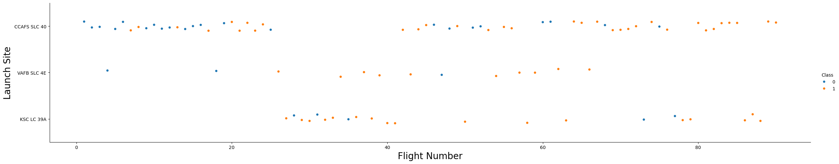
Flight Number vs. Launch Site
This scatter plot shows the occurrence of launches and their location in chronological order.

Slide 19
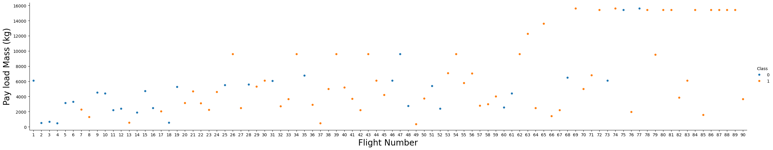
Payload vs. Launch Site
This scatter plot shows the size of the rocket pay load in chronological order.

Slide 20
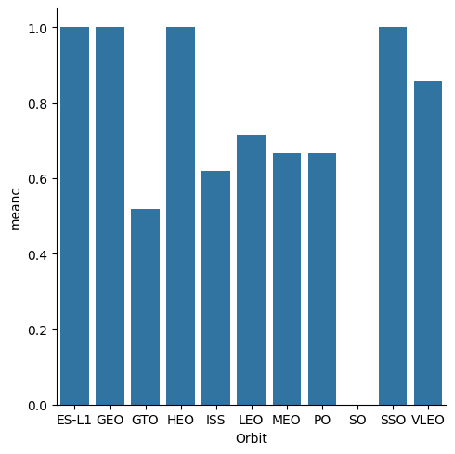
Success Rate vs. Orbit Type
This chart shows the success rate of each type of launch orbit, where 1.0 is 100%

Slide 21
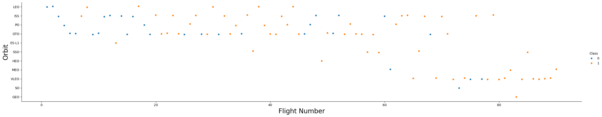
Flight Number vs. Orbit Type
This scatter plot shows the orbit of each flight in chronological order, with the color indicating whether the launch had succeeded (red) or failed (blue)

Slide 22
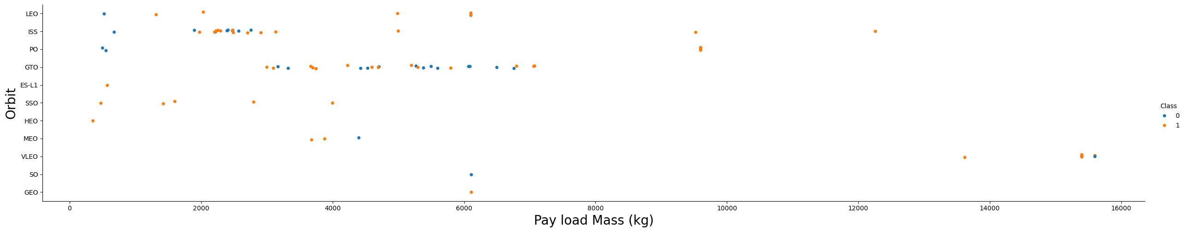
Payload vs. Orbit Type
This scatter plot shows the orbits achieved by different payload masses.
22

Slide 23
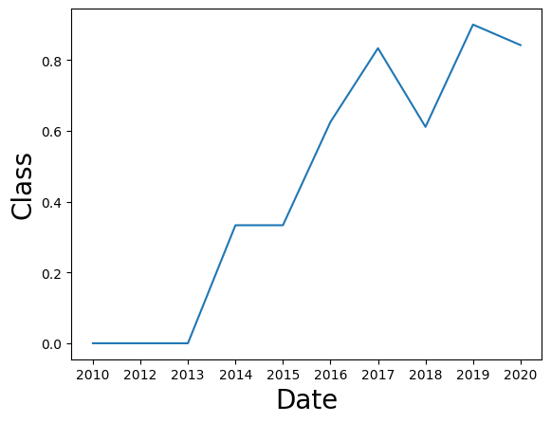
Launch Success Yearly Trend
This chart shows that the success rate of launches has increased over time, despite a noticeable dip in 2018

Slide 24
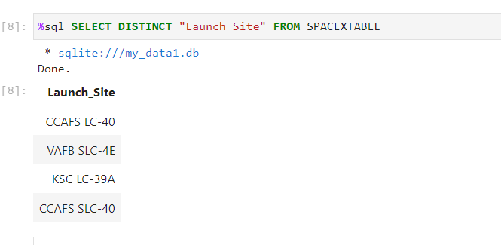
All Launch Site Names
This query shows a unique list of Launch Site names in the data

Slide 25
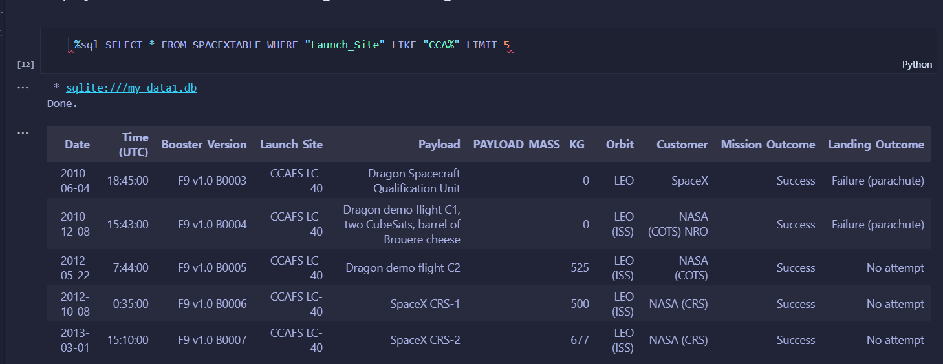
Launch Site Names Begin with 'CCA'
This query shows five rows whose Launch Site name begins with CCA

Slide 26
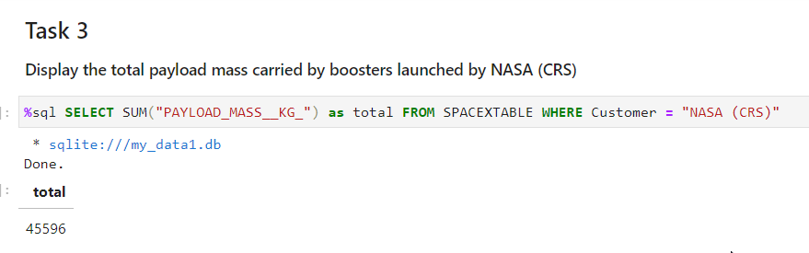
Total Payload Mass
This query calculates and returns the total payload mass for rockets launched for NASA

Slide 27
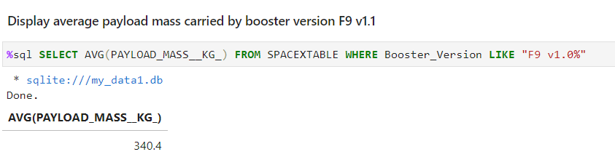
Average Payload Mass by F9 v1.1
This query calculates and returns the average payload mass carried by booster version F9 v1.1

Slide 28
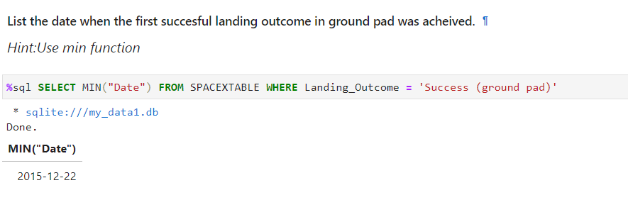
First Successful Ground Landing Date
This query locates the date of the first successful landing outcome on ground pad

Slide 29
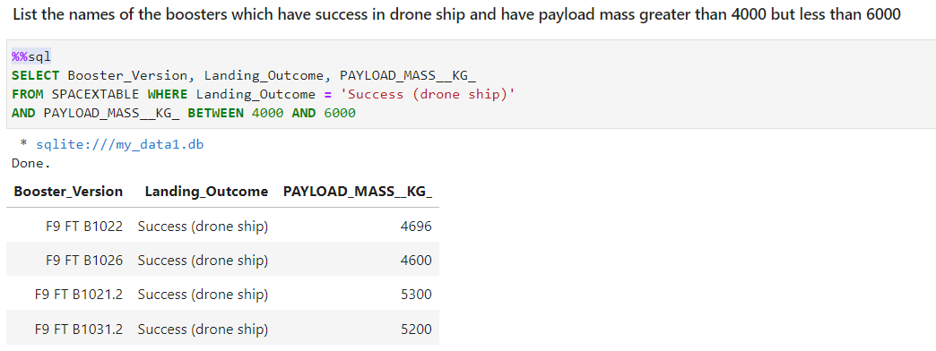
This query lists the names of boosters which have successfully landed on drone ship and had payload mass greater than 4000 but less than 6000tion here
Successful Drone Ship Landing with Payload between 4000 and 6000

Slide 30
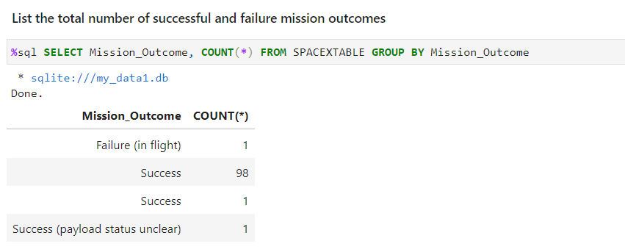
Total Number of Successful and Failure Mission Outcomes
This query calculates the total number of successful and failure mission outcomes

Slide 31
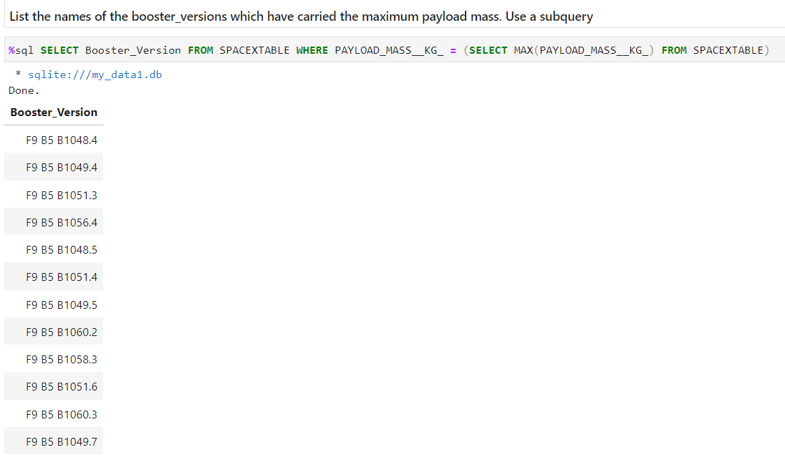
Boosters Carried Maximum Payload
This query lists the names of the booster which have carried the maximum payload mass

Slide 32
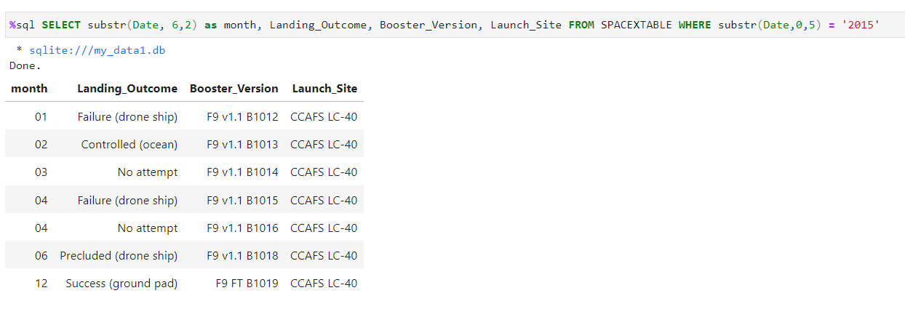
2015 Launch Records
This query lists the failed landing outcomes in drone ship, their booster versions, and launch site names for in year 2015

Slide 33
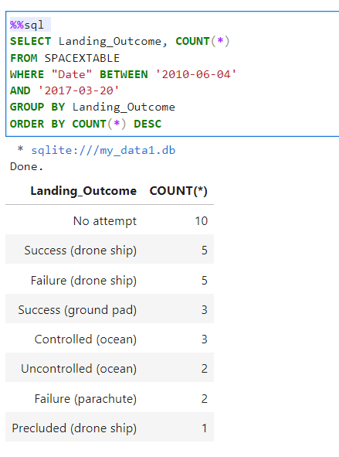
Rank Landing Outcomes Between 2010-06-04 and 2017-03-20
This query ranks the count of landing outcomes (such as Failure (drone ship) or Success (ground pad)) between the date 2010-06-04 and 2017-03-20, in descending order

Slide 34

Section 3

Slide 35
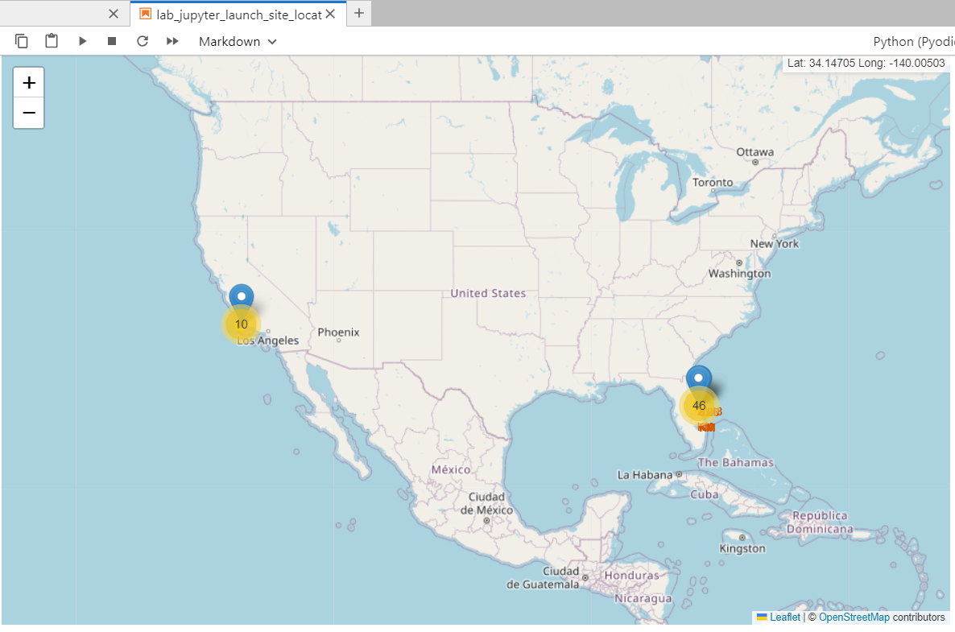
All SpaceX Launch Sites
The zoomed-out view of the generated Folium map shows:
The location of sites where SpaceX launches initiated
The number of launches at each site

Slide 36
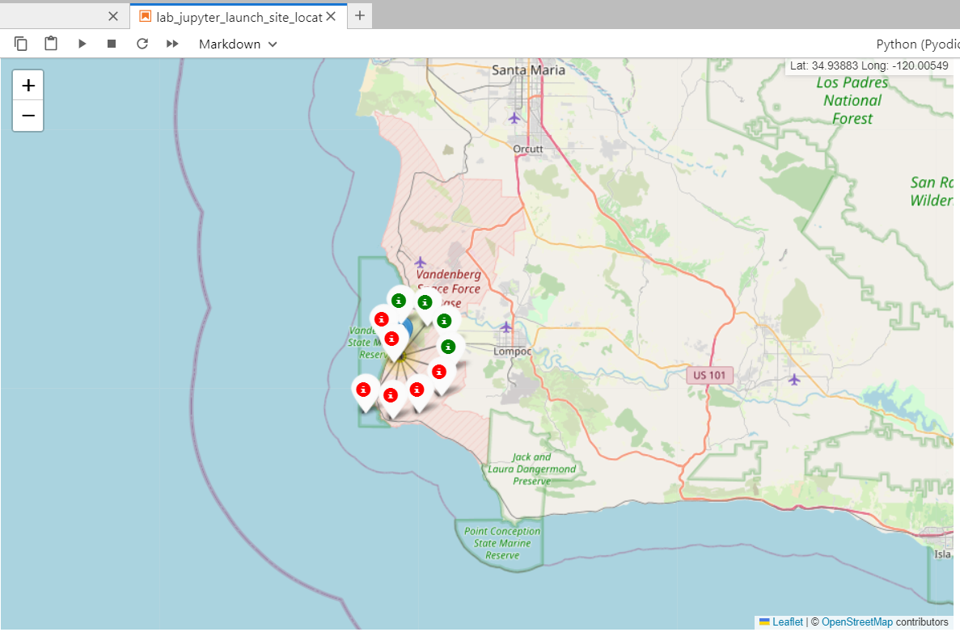
Launch Outcomes of Vandenburg Space Force Base
The attached map shows the launch outcomes of Vandenburg Space Force Base

Slide 37
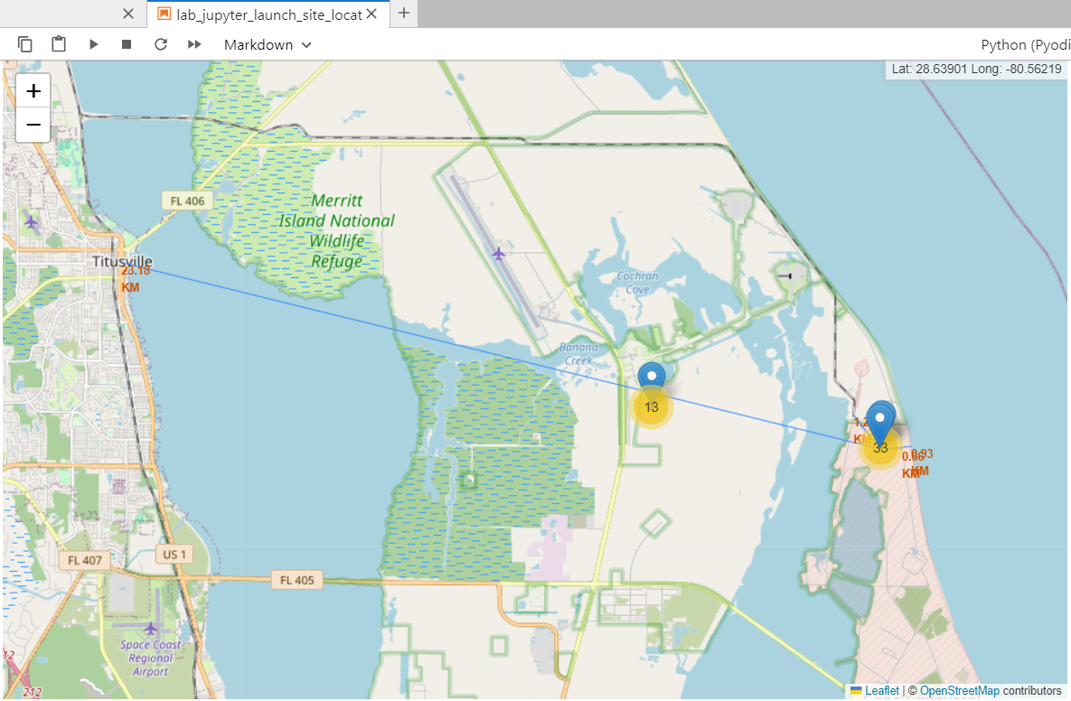
Nearest Landmarks to Cape Canaveral Space Center
The attached map shows distances from Cape Canaveral Space Center to the nearest:
Coastline (0.93km)
Highway (0.66km)
Railroad (1.26km)
City (23.18km)
These demonstrate that there is significant infrastructure to support the launch sites, but they are not located near cities.

Slide 38

Section 4

Slide 39
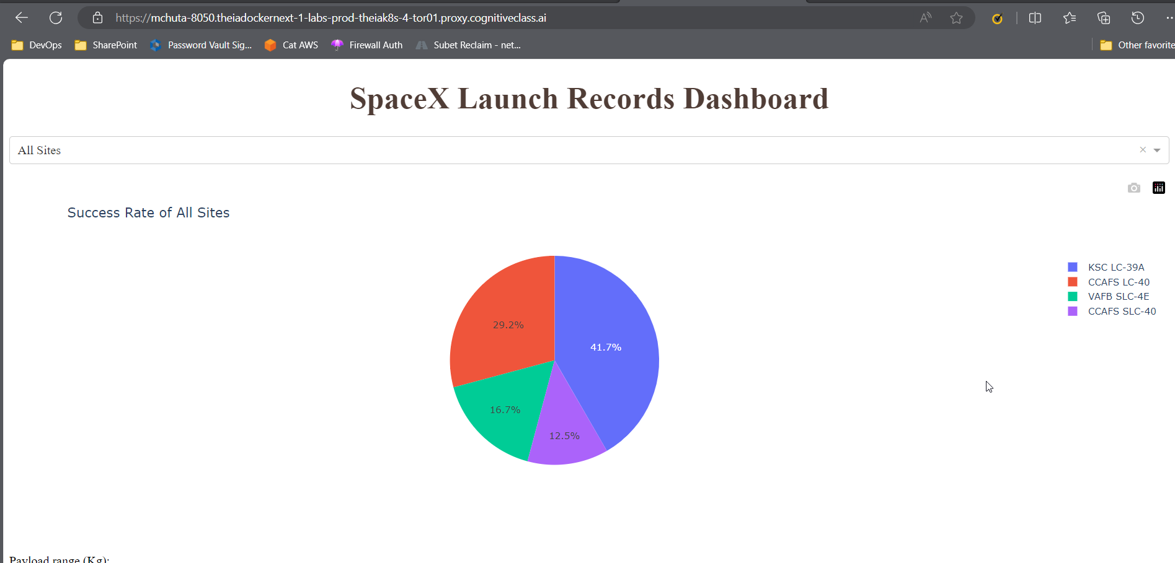
Success Rate of All Sites
The data show that the Kennedy Space Center (KSC LC-39A) had the most successful launches

Slide 40
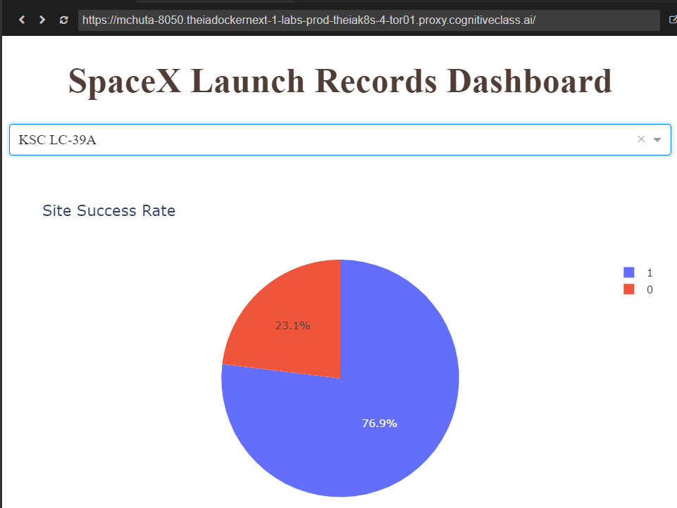
Most Successful Site – Pie Chart
The data show that the Kennedy Space Center (KSC LC-39A) had the most successful rate of launches.

Slide 41
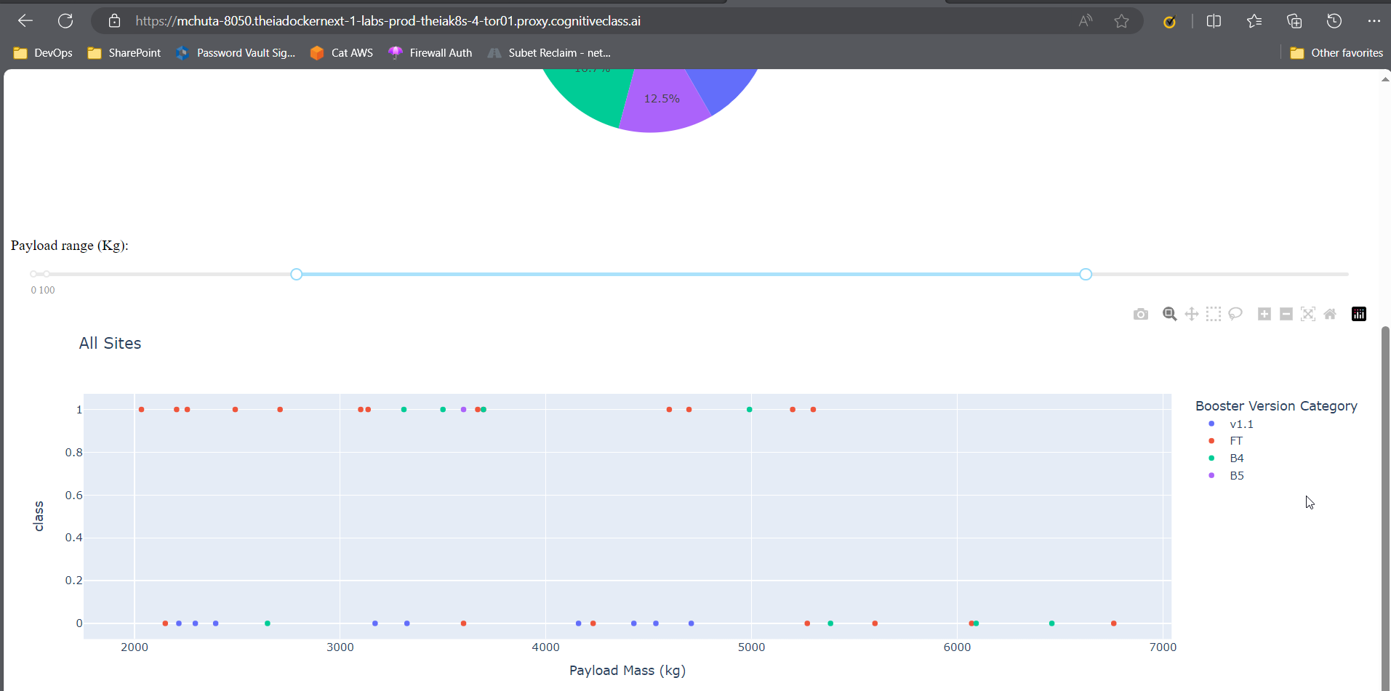
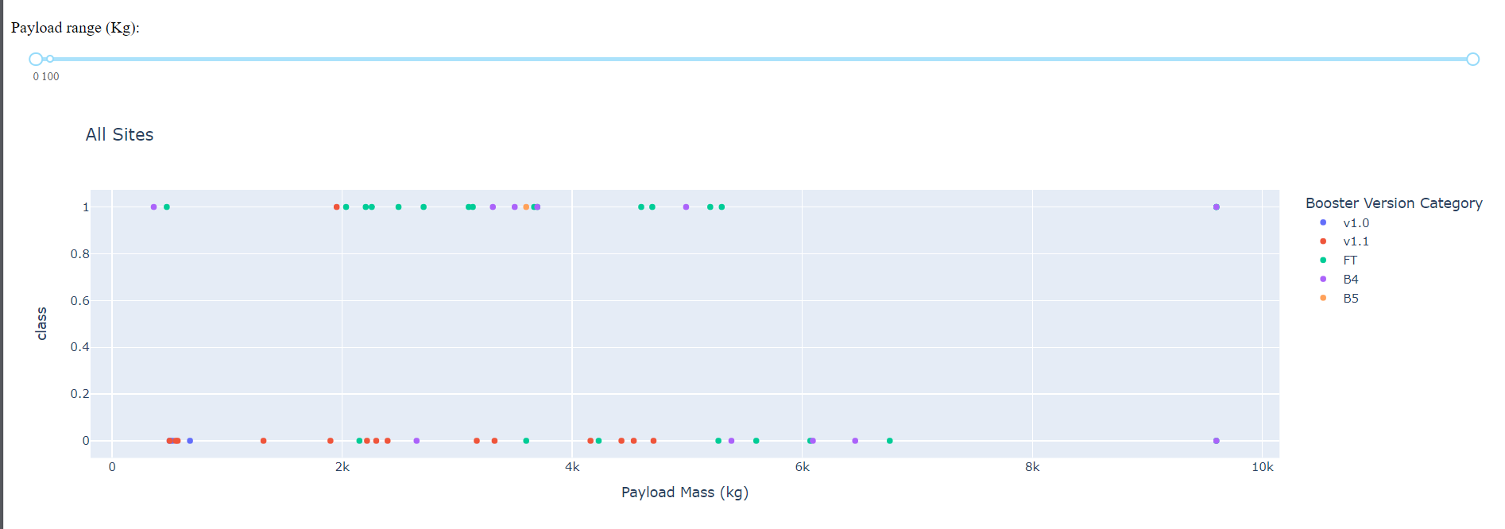
Payload Mass (kg) vs Success Rate by Booster Version
The data show the relationship between Payload Mass and Success Rate. They also show that there are no launches for the v1.0 Booster Version with Payload Mass between 2000kg and 7000kg

Slide 42

Section 5

Slide 43
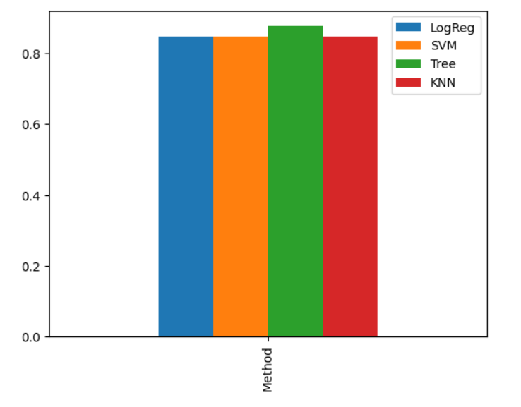
Classification Accuracy
The classification method with the highest accuracy was the Decision Tree, as shown in the bar chart to the right.

Slide 44
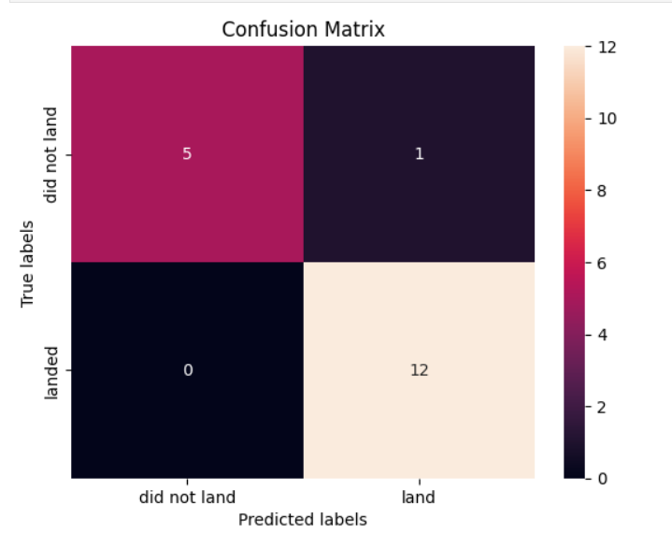
Confusion Matrix
The classification method with the most accurate confusion matrix is shown here. It was produced by the Decision Tree method.

Slide 45
Conclusions
SpaceX launches were most success from Kennedy Space Center in Florida
Launch sites are supported by heavy infrastructure (railroad and highways), near coastlines, and far from nearby population centers (cities)
A decision tree machine learning classification method was found to be the most accurate in predicting successful missions and performed the best on our test data.
Except for a slight dip in 2018, launches have been increasingly successful over time.
NASA has sent over 45 thousand kilograms of cargo into space by using SpaceX rockets

Slide 46


